Slide 1
Clinical Data Management in Prostate Cancer
Abhinav Mishra
131503

Slide 2
Prostate Cancer
Prostate cancer is one of the most common malignancies in men and a leading cause of illness and death in industrialized countries.
All patients with metastatic disease become un-responsive to hormonal therapy with time. Tumors treated with anti-androgen therapy eventually become androgen-independent and start to grow again.
In cases where the disease continues to progress even though testosterone ablation by surgical or hormonal treatment has been achieved, the disease is referred to as Hormone-Refractory Prostate Cancer (HRPC).

Slide 3
Recently, the scientiﬁc community’s demand for open sharing of data from these trials has encouraged sharing of patient-level data from clinical trials.
One such clinical trial data sharing platforms is the Project Data Sphere which aims at making raw data from cancer clinical trials available for research. The database currently holds data from the comparator arms of 55 cancer clinical trials.
There are many potential beneﬁts for the sharing of clinical trial data.
With trial data, available to the scientiﬁc community, trial results can be examined, reproduced and combined with other data to conduct meta-analyses.
Comparing treatments, outcomes and other disease-related patterns by meta-analysis can help gain a better understanding of the disease under investigation.
Notes:
Many cancer clinical trials are conducted each year.

Slide 4

https://www.projectdatasphere.org/projectdatasphere/html/home
Notes:
The abundance of raw, patient-level clinical data has great potential in leading to scientiﬁc advances in medical research and development of new techniques in clinical informatics.
Availability of patient-level data such as raw clinical measurements, rather than summarized table data, can allow researchers to independently verify published results as well as evaluate new hypotheses.

Slide 5
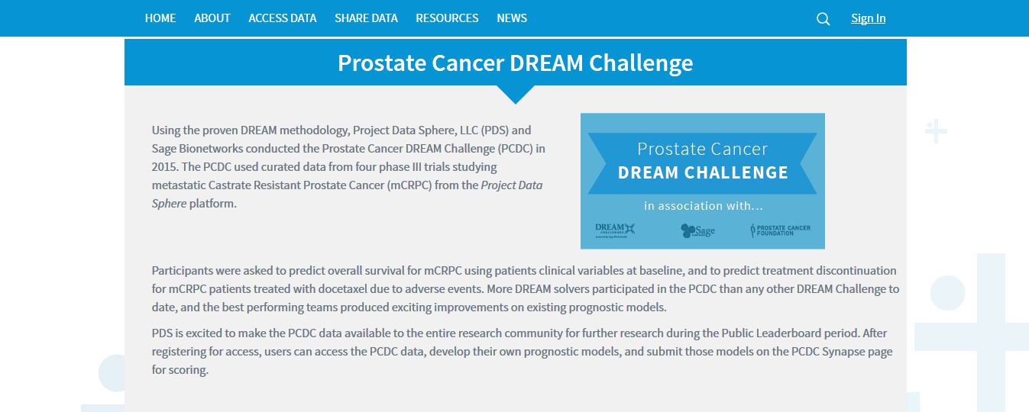
https://www.projectdatasphere.org/projectdatasphere/html/pcdc

Slide 6
Development of prostate cancer research database with the clinical data warehouse technology for direct linkage with electronic medical record system

Slide 7
Why ?
Most of the previous research database is completed by manual entry of physicians or clinical research coordinators or data entry staffs.
This data entry method is very labor intensive and cumbersome, so it usually fails to capture relevant data at early times.

Slide 8
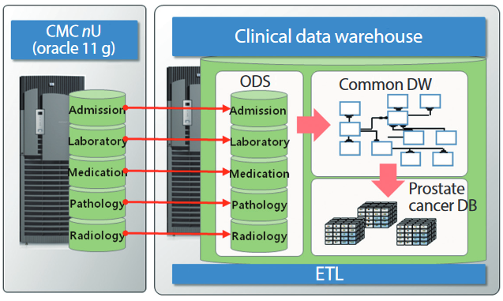
Fig. 1. Clinical data warehouse for electronic medical record link. CMC, catholic medical center; ODS, operational data store; DW, data warehouse; DB, database; ETL, extraction transaction loading .
The CDW is the method to develop clinical database that is optimized for distribution, mass storage and complex query processing.

Slide 9
To access and extract research information with less effort.
Comprehensive views of clinical data for specific purpose.
Quality data collection, and decision support capability by quick and efficient access to patient information and linkage to multiple operational data sources.
Accurate and high quality prostate cancer patients’ data can be collected from EMR system and feeds them to central prostate cancer registry system.
All eligible patients with newly diagnosed prostate cancer can be electronically transferred into the prostate cancer registry database from EMR system.
All registered patient information will be periodically updated
Notes:
Clinical data warehouse (CDW) technology
A CDW can provide numerous benefits to researchers with

Slide 10
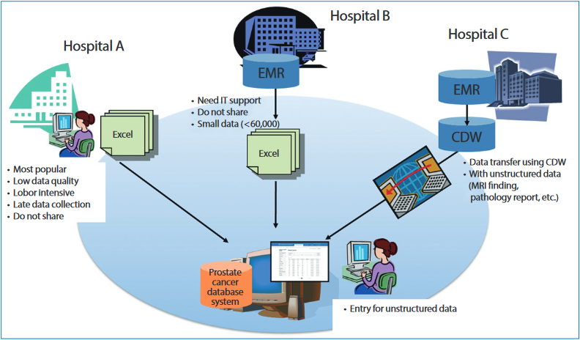
Fig. 2. Integrated prostate cancer database system

Slide 11
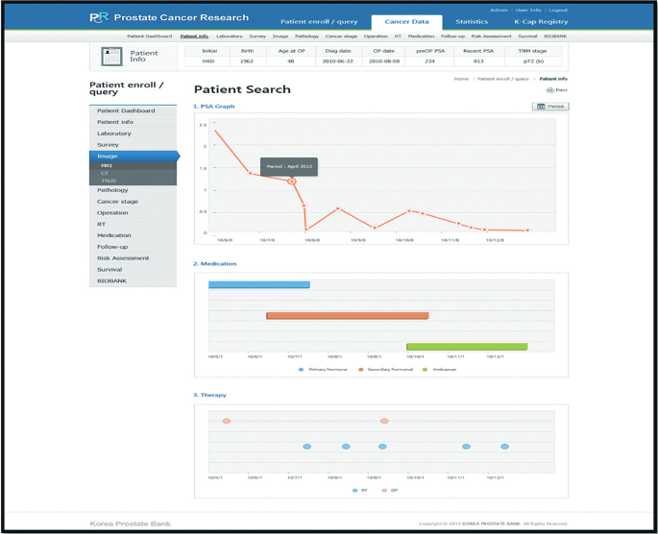
Fig. 3. Patient characteristics by treatment.

Slide 12
The proposed system can provide visualization integrating valuable information from different data sources.
Researchers interpret clinical effectiveness in place and can be the turning point in uncovering new insights and knowledge about a patient or a disease.
This database system could provide the infrastructure for collecting data on the quality of prostate cancer care.
The large database system, like J-CaP and CaPSURE, can provide valuable real-world information and would help advance clinical management of prostate cancer patients in the future.

Slide 13
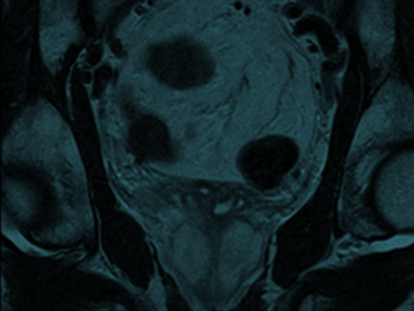
First Year Annual Report Organization of Services and Analysis of Existing Clinical Data
Source : http://www.npca.org.uk

Slide 14
NHS providers should ensure that multiparametric MRI is more widely available to decrease the likelihood of unnecessary re-biopsy and to improve staging and treatment decision making for patients with potentially curable disease where indicated.
The availability of high-dose rate brachytherapy should be increased for men with intermediate and high-risk localized or locally advanced prostate cancer.
The availability of personal support services including cancer advisory centers, sexual function and continence advice, and psychological counselling should be improved.
Patients with prostate cancer should have access to a CNS with an appropriate background in uro-oncology.
NHS providers should ensure that patients have access to a joint clinic with a surgeon, an oncologist and a CNS to discuss their treatment options.

Slide 15
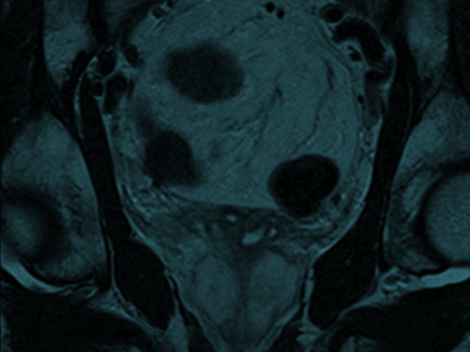
Second Year Annual Report – Further analysis of existing clinical data and preliminary results from the NPCA Prospective Audit 2015
Source : http://www.npca.org.uk

Slide 16
The initial results of the NPCA Prospective Audit(2015) demonstrates its potential to evaluate practice and outcomes of prostate cancer services. However, there is a need for further improvements in Trust participation, case ascertainment and data completeness
The collection of complete and accurate staging data is a key priority. More complete collection of data on nodal and metastatic disease will help to better distinguish between men with locally advanced and advanced (metastatic) disease
Clinical practice is gradually falling in line with current recommendations which advocate that patients with low-risk disease are offered active surveillance – in order to avoid over-treatment – and those with locally advanced disease are offered radical treatment – in order to avoid under-treatment
Length of stay after radical prostatectomy is reducing and only 22% of patients diagnosed between 2010 and 2013 stayed longer than three days in hospital
There was considerable regional variation in the treatment of men with locally advanced disease diagnosed between 2010 and 2013. This variation may partly reflect problems in identifying men who had radical treatments and partly differences in actual treatment

Slide 17
What is the solution ?
Researchers who provide timely access to clinical trial data are meeting their duty to trial participants and funders as well as helping to ensure that physicians and patients do not have to make decisions based on partial evidence.
In the future, access to de-identified patient data within a specified time frame should be a precondition for receiving public funding, and breach of the agreement should lead to cessation of funding until data are shared.
Notes:
Ian Haines and colleagues call for access to all the publicly funded clinical trial data from two major trials to settle the controversies around screening for prostate cancer with prostate specific antigen.
European Randomized Study of Screening for Prostate Cancer(ERSPC) and the Gothenburg trial.

Slide 18
Data Analysis Tools
SEER*Stat is a software used to analyze SEER data.
Joinpoint is a software used to analyze trends in data.
DevCan is a software used to calculate lifetime risks of getting or dying from cancer.
HD*Calc is a software that generates summary measures for evaluating and monitoring health disparities
Notes:
The SEER*Stat statistical software provides a convenient, intuitive mechanism for the analysis of SEER and other cancer-related databases. It is a powerful PC tool to view individual cancer records and to produce statistics for studying the impact of cancer on a population. SEER*Stat software is distributed with the SEER Research Data and you must have access to the data before using the software.
Joinpoint is statistical software for the analysis of trends using joinpoint models, that is, models like the figure below where several different lines are connected together at the "joinpoints". Cancer trends reported in NCI publications are calculated using the Joinpoint Regression Program to analyze rates calculated by the SEER*Stat software.
DevCan takes cross-sectional counts of incident cases from the standard areas of the Surveillance, Epidemiology, and End Results (SEER) Program conducted by the National Cancer Institute, and mortality counts for the same areas from data collected by the National Center for Health Statistics, and uses them to calculate incidence and mortality rates using population estimates from census data for these areas. These rates are converted to the probabilities of developing or dying from cancer for a hypothetical population. It supports rate editing, sensitivity analysis, user-defined databases, confidence intervals, and the ability to get risk estimates from any age to any age.
The Health Disparities Calculator (HD*Calc) is statistical software designed to generate multiple summary measures to evaluate and monitor health disparities (HD). HD*Calc was created as an extension of SEER*Stat that allows the user to import SEER data or other population-based health data and calculate any of eleven disparity measurements.
HD*Calc supports the use of a range of health disparities measures, allowing researchers to select and apply different measures to their data. HD*Calc was originally developed to expand the range of measures for evaluating health disparities related to cancer. However, since it can be used with any dataset, HD*Calc can be used in any research arena. Cross-sectional and trend data (e.g., cancer rates, survival, stage at diagnosis) categorized by disparity groups (e.g., area-socioeconomic status, race/ethnicity, geographic areas) can be imported into HD*Calc to generate four absolute and seven relative summary measures of disparity. The results are displayed as tables and charts, which may be exported for use in other applications.

Slide 19
Caisis - An Open Source, Web-based, Patient Data Management System to Integrate High Quality Research with Patient Care
PCCTC offers Caisis, a web-based clinical oncology data management system fully integrating research with patient care.
For over a decade, collaboration with over 25 institutions has allowed Caisis to develop and evolve in an environment of constant feedback and scrutiny.
Accordingly, Caisis clinical trial management and electronic data capture tools can be customized to fit the scale and complexity of each new project.
Notes:
Fred Hutchinson Cancer Research Center
Westmead Cancer Institute
U of Virginia Health System
New York University Langone Medical Center
Karmanos Cancer Institute
Baylor College of Medicine
Cleveland Clinic
George Washington University
Leroy T Canoles Jr. Cancer Research Center
McGill University
University of Queensland
Australian Prostate Cancer Research Centre
University Health Network Princess Margaret Hospital
Capital Health / Dalhousie University
Memorial Sloan-Kettering Cancer Center
Groupe Hospitalier Diaconesses Croix Saint Simon
University of Washington
University of Miami
National Cancer Center Singapore
Cancer Research UK
MD Anderson Cancer Center
University of Rochester
Eastern Virginia Medical School University Hospitals Seidman Cancer Center Columbia University Fox Chase Cancer Center U of Alabama at Birmingham University of Malmö Foundation Biobank-Suisse OHSU Knight Cancer Institute King Khalid University Hospital Capital Health / Dalhousie University University of Pittsburg Masonic Cancer Center, U of Minnesota Urology of Virginia PLLC IU Simon Cancer Center RG Kar Medical College Latin American Cooperative Oncology Group (LACOG) St. James's Hospital CancerCare Manitoba Mt. Sinai Fundació IBIT Royal Melbourne Hospita
The Prostate Cancer Clinical Trials Consortium (PCCTC) was initiated in 2005 by the Prostate Cancer Foundation (PCF) and the U.S. Department of Defense (DOD) Prostate Cancer Research Program (PCRP) in response to critically unmet needs in prostate cancer clinical research identified by physician investigators and patient advocates.

Slide 20
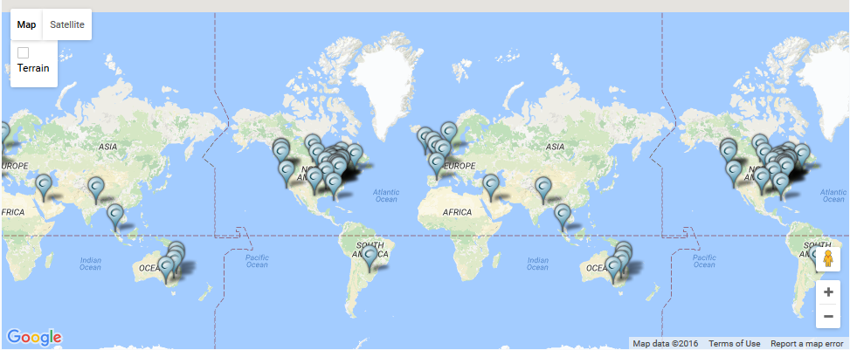
Fig. 4. A map of some of the institutions where the Caisis application is being utilized.
Source : http://www.caisis.org/collaboration.html

Slide 21
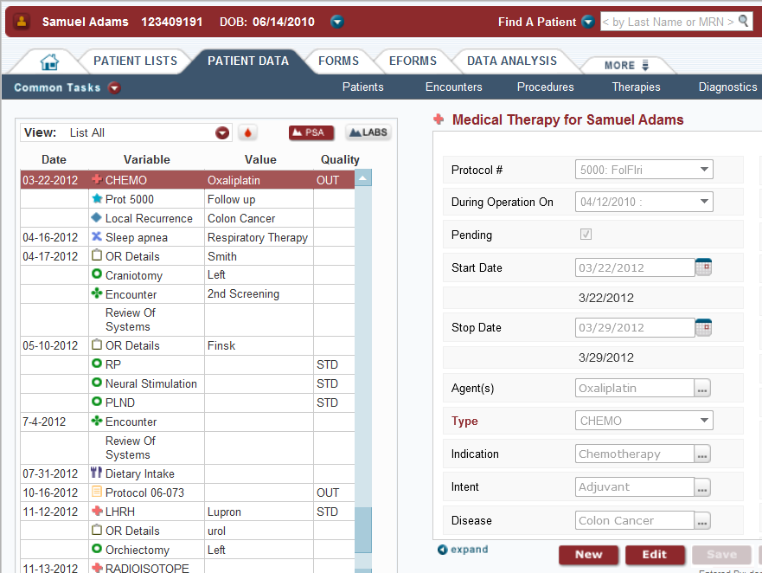
Flexible Forms for Data Collection
Highly customizable forms
Chronological summary of patient history
Auditing of data collection and user activity
Views configurable by disease
Robust relational datamodel for structured data elements
Extensive fields for granular research data
Standard and configurable vocabulary

Slide 22
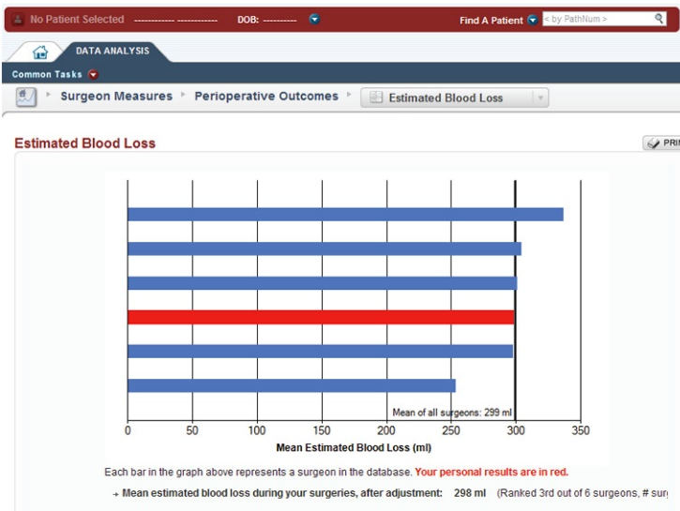
Data Analysis
Rapid report creation using configurable query files
Export to common formats such as Excel and Access
Full auditing of report views and exports
Support for robust charting
Integration of R statistic library for advanced functions

Slide 23
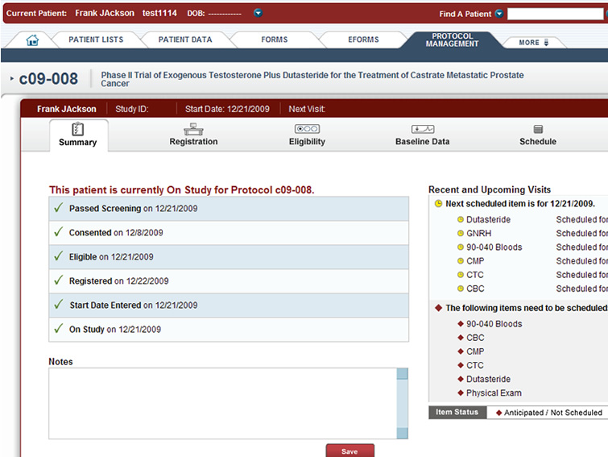
Protocol Manager
Patient study calendar that integrates the patient schedule and data entry
Serious adverse event reporting
Outcomes management for Biomarker, Soft Tissue, and Bone response
Data entry customization by protocol
Registration and Eligibility tracking

Slide 24
References
Geifman, N., & Butte, A. . (2016). A patient-level data meta-analysis of standard-of-care treatments from eight prostate cancer clinical trials. Scientific Data,3,160027.
Choi, I. Y., Park, S., Park, B., Chung, B. H., Kim, C.-S., Lee, H. M., … Lee, J. Y. (2013). Development of prostate cancer research database with the clinical data warehouse technology for direct linkage with electronic medical record system. Prostate International,1(2),59–64.
Djulbegovic, M., Beyth, R. J., Neuberger, M. M., Stoffs, T. L., Vieweg, J., Djulbegovic, B., & Dahm, P. (2010). Screening for prostate cancer: systematic review and meta-analysis of randomised controlled trials. The BMJ, 341, c4543.
Haines Ian E, Ablin Richard J, Miklos George L Gabor. Screening for prostate cancer: time to put all the data on the table (2016).The BMJ; 353 :i2574
Caisis: An Open Source, Web-based, Patient Data Management System to Integrate High Quality Research with Patient Care. Retrieved from http://www.caisis.org/features.html

Slide 25
Thank you !

